Slide 1
Ad Tech That Reduces Carbon Emissions
U.S. Patent No. 11,195,210

Slide 2
Sequency™ is the sustainability solution for marketers looking to reduce their carbon footprint
and save on ad spend.
Our innovative ad tech reduces wasteful
multiple Cookie Syncs, and SSP/DSP ad calls, increases ad viewability and reduces the effective CPM of each ad delivered.

Slide 3
What is Sequency™
Buy-Side Ad Product Designed to Reduce Carbon Emissions
A
Sequency™ enables media Buyers to purchase One display ad impression
with the ability to serve up to four ads to a targeted consumer, without
multiple SSP/DSP calls and additional Cookie Syncing.
B
Enables the Buyer to set the percentage of Pixels that are in-view and
the Duration that the ad is In-View that is measured in REAL-TIME.
Usually 15 seconds.
C
Create a “Pod” of Highly viewable ad impressions within that Ad Unit the
buyer now “Owns”…in Real-Time.
D
Reduce CPM costs, increase margins and deliver ads that are always
In-View for a set duration… PLUS substantially reduce CARBON emissions

Slide 4
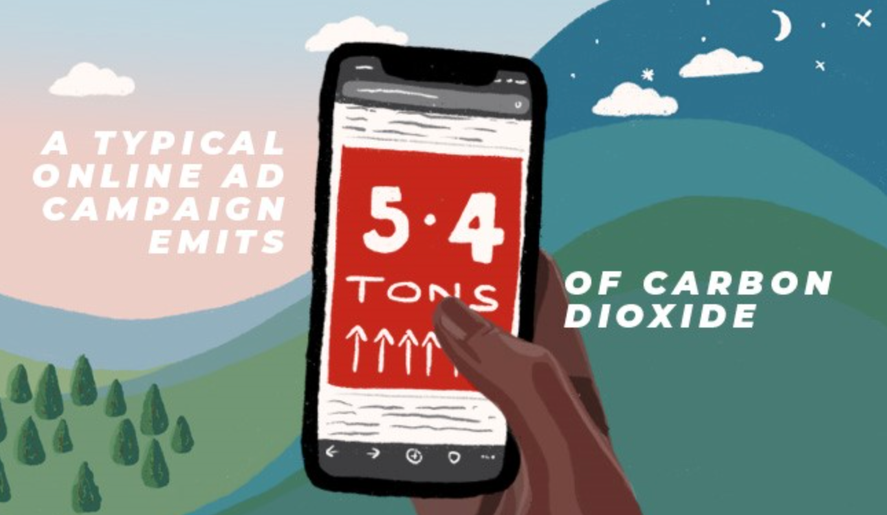
USE CASE
Agency Delivers Four Ads from Four Different Brands to the Same Targeted User

Slide 5
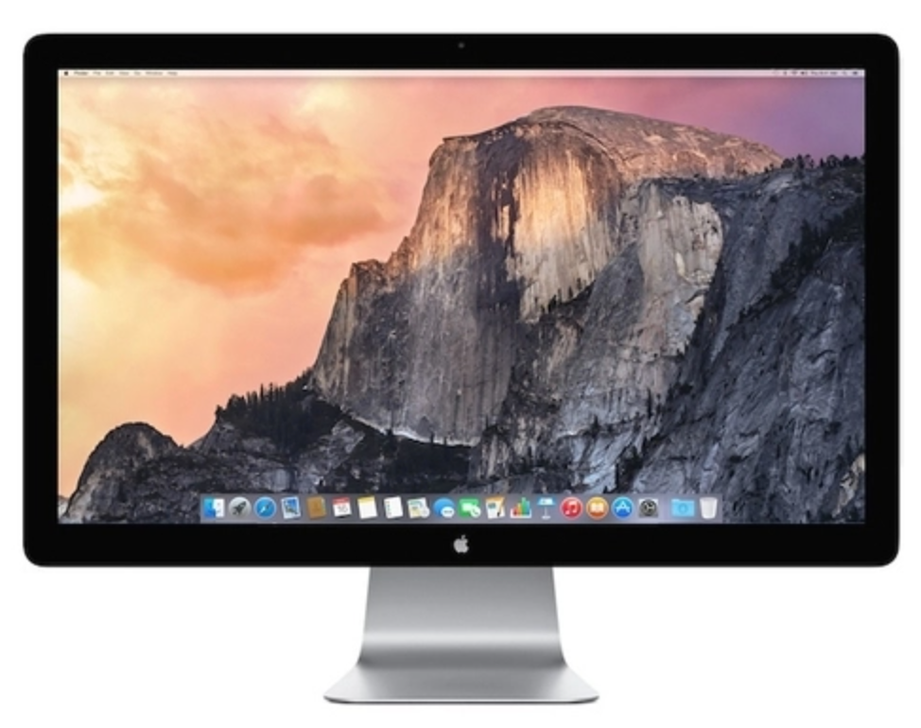
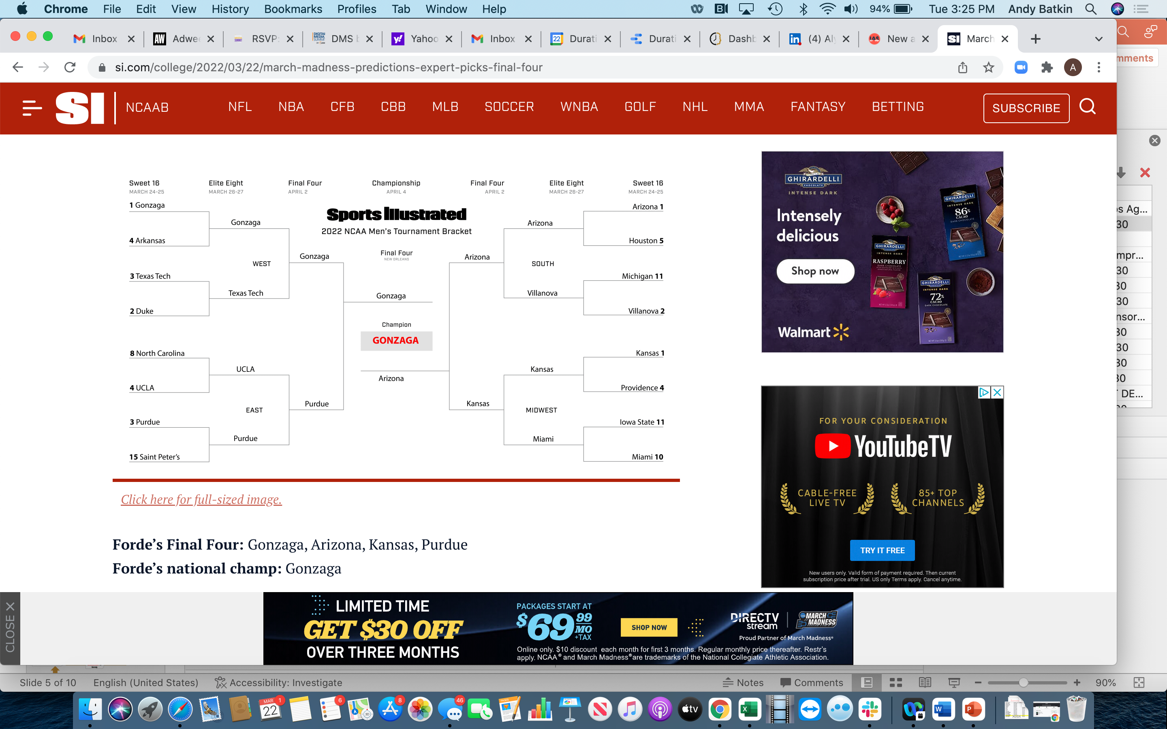
Viewability-as-a-Service™
Four Different Brands
Brand and Agency View Duration Media
Reporting
DSP Invoices
Duration Media Measures Pixels and In-View Time and Pings SSP to Execute PMP
DSP Delivers Ad Via Open Market
Pub Agrees Not
to Refresh The Ad
Duration Media
Wraps Agency Creative
With VaaS™ Ad Tech
PMP Deal Negotiated With
The Publisher

Slide 6
USE CASE
Mars Delivers Four Ads from their Portfolio of Brands to the Same Targeted User

Slide 7
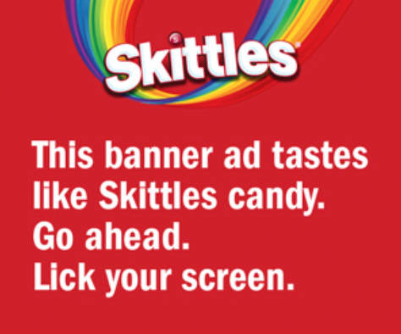
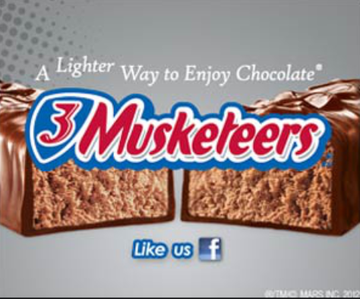
Viewability-as-a-Service™
Four Mars Brands
Brand and Agency View Duration Media
Reporting
DSP Invoices
Duration Media Measures Pixels and In-View Time and Pings SSP to Execute PMP
DSP Delivers Ad to Targeted User Via Open Market
Pub Agrees Not
to Refresh The Ad
Duration Media
Wraps Agency Creative
With VaaS™ Ad Tech
PMP Deal Negotiated With
The Publisher

Slide 8
USE CASE
Four Ads Are Delivered Sequentially from
M&Ms to the Targeted User

Slide 9
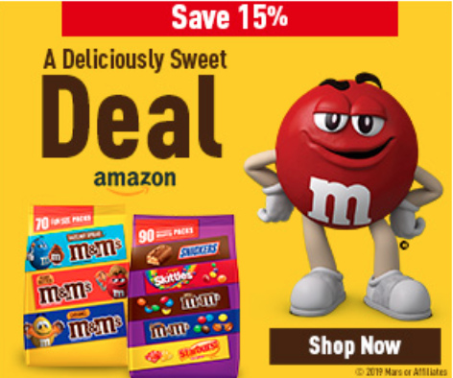
Viewability-as-a-Service™
M&Ms
Brand and Agency View Duration Media
Reporting and
DSP Invoices
Duration Media Measures Pixels and In-View Time and Pings SSP to Execute PMP
SSP Delivers Ad to Targeted User Via Open Market
Pub Agrees Not
to Refresh The Ad
Duration Media
Wraps Agency Creative
With VaaS™ Ad Tech
PMP Deal Negotiated With
The Publisher

Slide 10
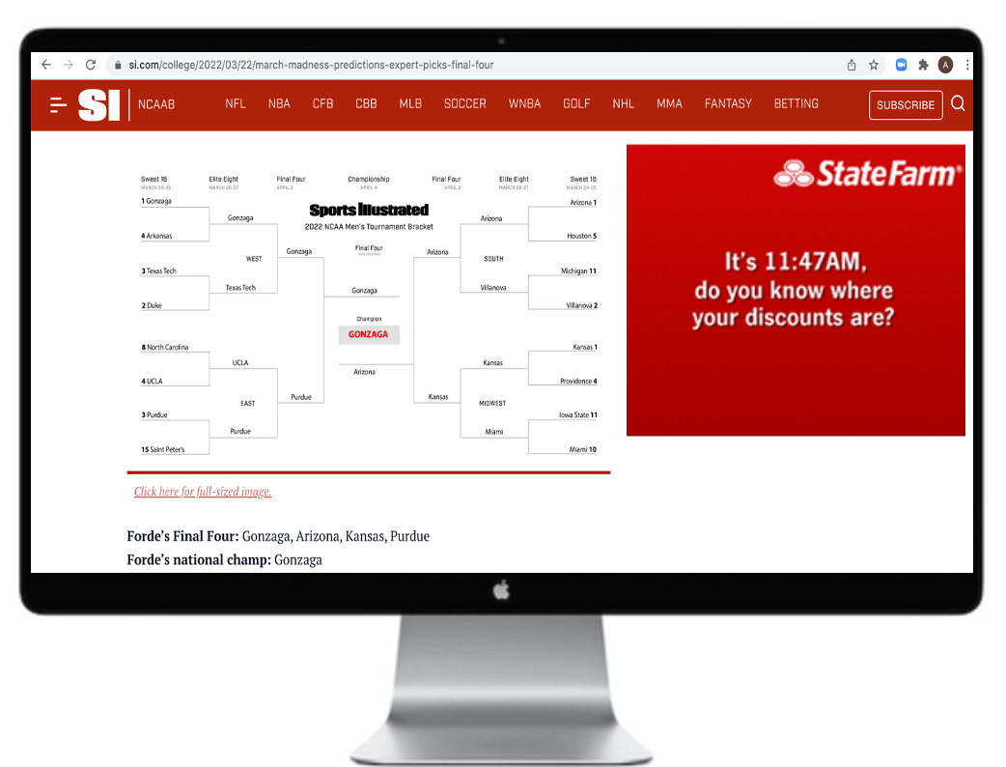
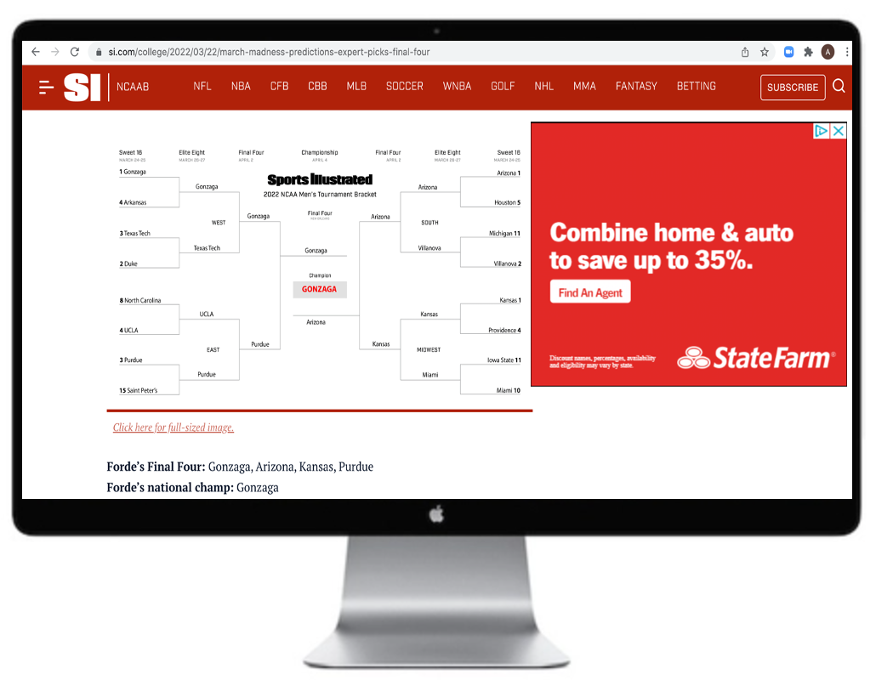
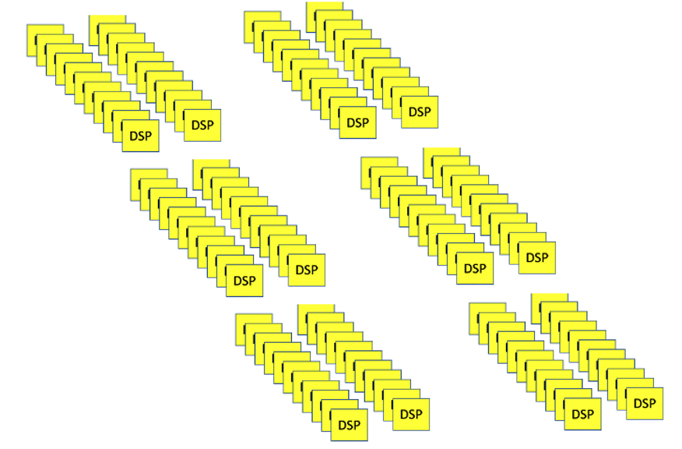
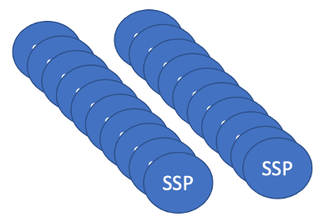
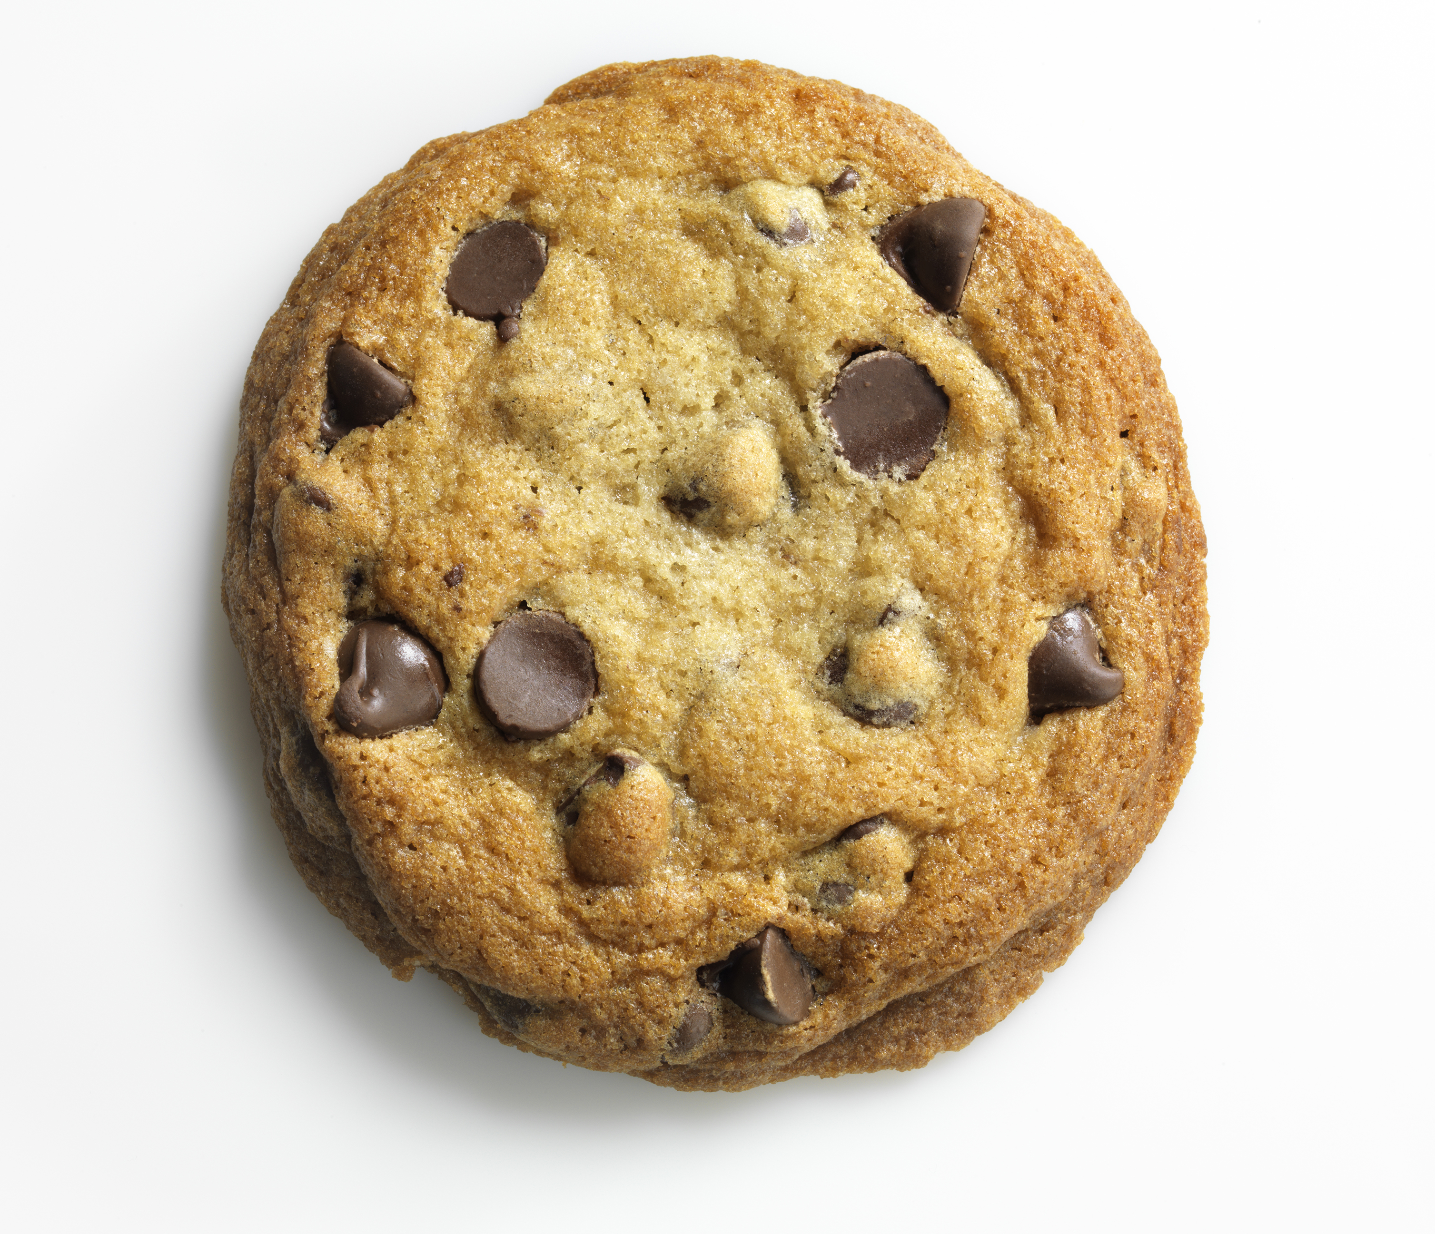
Sequency™ PMP Reduces CO2
2nd-4th Ad Delivery Using
Sequency™
1st Ad Delivery
*Average 27 SSPs
*135 Bid Requests
*Average 20 DSP Integrations
1 SSP
1 DSP
SSP
DSP
*25% Get Bids
X
*Jounce Media Data
Plus ALL the Cookie Syncs
ONE Cookie Sync for Ads 2-4

Slide 11
Sequency™ Benefits
A
Buyers reduce CPM costs, increase margins and Publishers earn
more PMP and direct demand revenue.
Assumptions:
PMP Deal structured at $2 cpm vs normal $1 cpm
4 Ads served establishing an eCPM of $.50
Advertiser receives 15 seconds of in-view time & lower cpms
Publisher generates more PMP revenue
B
Carbon Emissions are drastically reduced!
Assumptions:
4 Ads served
ONE SSP/DSP ad call & Cookie Sync on ads 2-4
Carbon Emissions are Substantially reduced
No need for Off-Sets or payment of another Ad Tax
Sequency™ is a profit center, not a cost center

Slide 12
QUESTIONS
AND
DISCUSSION
Contact:
Andy Batkin
CEO & Founder
abatkin@durationmedia.net

